Slide 1

딥러닝 (Deep Learning)
Homework 7
Natural Language Processing using Neural Models (NLG)

Slide 2

Programming assignments
Deep Learning Basic MLP
Object Recognition ResNet
Face Recognition Free choice model
NLU CNN for Sentence Classification
Object Detection YOLO
Image Generation GAN, CGAN, DCGAN
NLG LSTM
SSL for Computer Vision ViT
SSL for NLP BERT
LLM ChatGPT

Slide 3
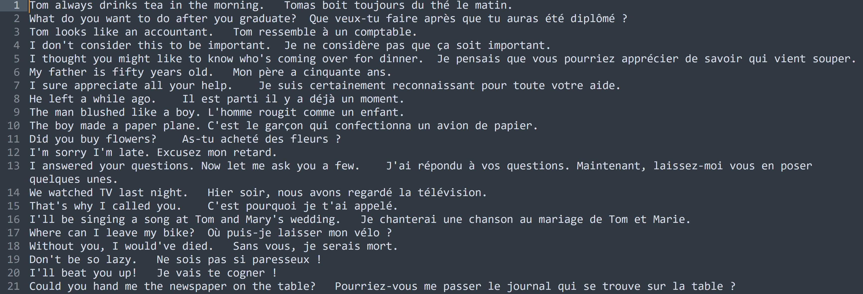
Assignment 7: RNN for machine translation
[Dataset]
Data | Description | Source&Target
Eng-fra | Machine translation (EN-FR) dataset | English&French

Slide 4
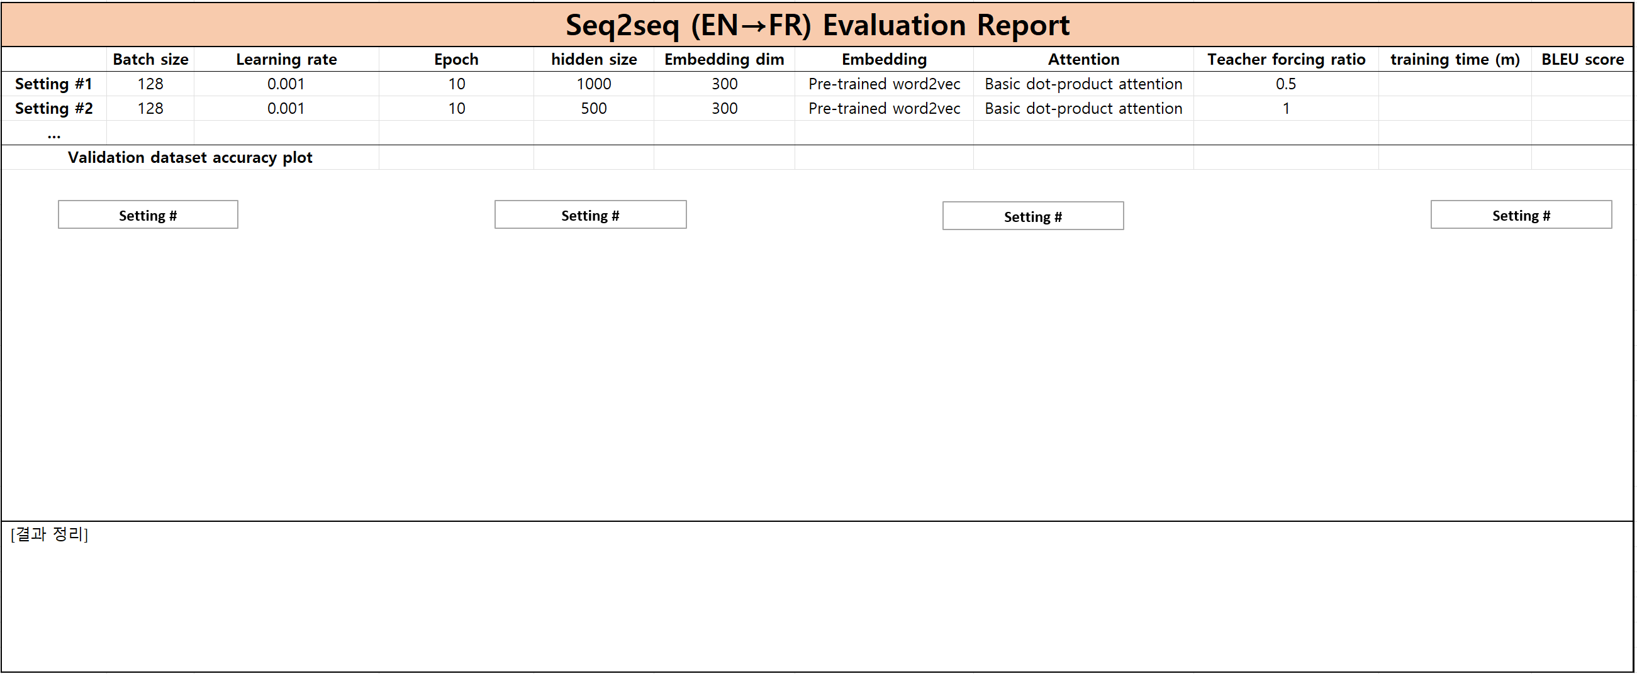
Assignment 7: RNN for machine translation
[Evaluation report]
어텐션 구현하면 돌아가게 되있음
W 줄거면 basic dot product (그냥 내적)
말고 그 어텐션 쓰면댐 (필수아님)

Slide 5
Assignment 7: RNN for machine translation
Evaluation Criteria
Simplicity | How concisely did you write the code? 배점 3점 EN2FR data preprocessing: 1점 Attention mechanism: 1점 Inference an English sentence: 1점
Performance | How well did the results of the code perform? - 배점 2점 EN2FR BLEU score 40 이상 달성: 2점
전처리
Dot product 만 하면 됨
영어문장 넣어보기

Slide 6
Assignment 7: RNN for machine translation
Due to : ~ 5/28 (Wed) 23:59:59
Submission : Online submission on cybercampus
Your submission should include
The whole code of your implementation
The evaluation report
You must implement the components yourself!
File name : StudentID_Name_HW7.zip

Slide 7
Q&A

